Slide 1
Texas WIC Shopping Experience Research & UI Testing

Slide 2
Introduction
Social marketing: create campaigns based on research to change behaviors
Qualitative research: based on pattern of responses and considered directional
Few = 2 or 3 interviewees
Several = 4-6
Half = 7 or 8
Many = 9-12
Most = 13-15
All = 15
Notes:
SUMA Social Marketing has a 20+ year history of employing social marketing techniques to serve clients’ needs. Social marketing is the use of commercial marketing principles and techniques to improve the welfare of people and the physical, social and economic environment in which they live. It is a carefully planned, long-term approach to changing human behavior. The nature of SUMA’s research is qualitative, meaning rather than dealing with numbers and figures, researchers study participant responses for patterns and report on the trends that emerge. This presentation reports the feedback and perceptions WIC moms and healthcare providers currently have about breastfeeding support based on their experiences.

Slide 3
Presentation Agenda
Research Goals
Findings from WIC Staff Focus Groups
Findings from WIC Client Interviews
Closing Thoughts
Recommendations
Group Discussion
Notes:
Dallas users

Slide 4
Research Goals
For WIC Staff Focus Groups:
Explore how to improve staff-facing teaching tools to help staff educate clients on shopping for WIC foods
Determine additional features staff would like to see in the TXIN system for themselves and clients

Slide 5
Research Goals
For WIC Client Interviews:
Improve the client shopping experience
Improve client-facing educational tools on shopping for WIC foods
Conduct UI testing for TXIN portal app mock ups & myTexasWIC shopping app

Slide 6
Staff Focus Groups
N=27

Slide 7
4 Focus Groups (N = 27)
WIC Staff
Across Texas
Online webcam groups
Each group had 6-7 participants
WIC career = 7 mos – 30 years

Slide 8
Rollout of Mosaic as a Movie
From horror & drama, to sci-fi & romantic comedies, most recalled some dramatic, chaotic early days followed by relative calm
“
Star Trek – it’s an adventure – we never know where we’re headed.
–Group One
“
Like a romantic comedy – a love-hate relationship.
–Group Four
Notes:
Dallas users

Slide 9
If You Had a Magic Wand…
…what changes would you make to TXIN?
Has improved greatly, but still some challenges:
Multiple tabbing
Vena inputting
Updating process
Formula/prescription issues
Prior pregnancy reporting
Appointment system
“
Sure, there could be things better, but from where we came from to where we are now, I’m like great.
–Group One
“
Notes:
Dallas users

Slide 10
“
I think it would be easier for formula if it was all on one page instead of constantly clicking on it and opening new tabs or new pages. That can go the same with the participants, too. It should be easier to open up multiple participants than copying and pasting an FID number and opening multiple tabs for large families.
–Group One
”

Slide 11
Portal App for Clients
Great idea – most WIC clients are tech savvy & have smart phones
Some were concerned about the small percentage of clients who lack tech skills or access, mostly first-gen immigrants
A few concerned about clients making their own appointments
“
I think it would be something that - maybe even half of our population would benefit from because we also have really young moms who don’t want to go through the whole process of calling & having to talk to someone because they’re more comfortable with the computer.
—Group Two
“
Notes:
12 minutes
Women like themselves, trusted source,

Slide 12
App for Staff
Half said they would download a staff on their personal phones
Not overly enthusiastic
Already have email, chat, & notifications on work computers that they’re on all day
“
We use Microsoft Teams for that. We share documents. We don’t have in-person staff meetings right now so we’re using it to maintain work relationships and say good morning and things like that.
—Group Two
“
I wouldn’t want it on my personal cellphone. I like to do my business here.
—Group One
Notes:
12 minutes
Women like themselves, trusted source,

Slide 13
Shopping Experience & Education
History of being problematic for clients and vendors
Staff are main source of training for clients, and their approach varies widely
Most use shopping guide & list
Some knew about the clinical teaching tool, but don’t use it
Shopping app & video is helpful
“
I will text the YouTube video to every new client.
—–Group Four
“
Notes:
Dallas users

Slide 14
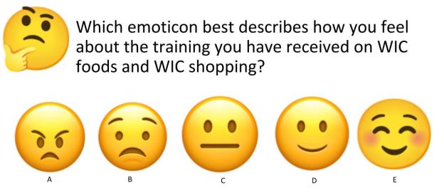
Half of staff
Half of staff
“
Training varied widely
Some were never trained, as in 2015
Some expressed frustration with lack of training
I’d have to say a “B.” I didn’t get any training on shopping & I’ve just self-taught myself. I was on WIC with my children so I understood, that each & every one of my clients, if they’re new, I go over the book with them & show them about cereals and all that stuff.
—–Group Two
“
Notes:
Dallas users

Slide 15
Most important to tell WIC clients:
Download app
Use all benefits
Look for pink stickers
Separate WIC foods
Go to WIC store
Pay attention to brands

Slide 16
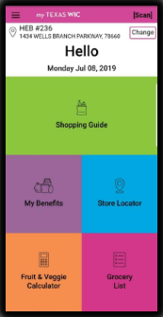
myTexasWIC Shopping App
Huge step forward for clients & staff
Feedback from clients = overwhelmingly positive
Most are familiar with it, but would like a refresher
“
I think it’s being used. I think everyone likes it. They don’t have to carry the shopping guide. They can just pull it up on the app and see what they have left. So, it’s good.
—Group Three
“
Notes:
Dallas users

Slide 17
Million Dollar Idea
Auto-upload benefits to card
Make stores less confusing
Decrease or eliminate juice
Add more produce
WIC-only section in stores
“
I would say just the food packages, more dollar amount for fruits and vegetables. They don’t really need juice on the program. I don’t know why we offer juice, personally, so change it to the food package because we are a nutrition program.
—Group One
“
Notes:
Dallas users

Slide 18
WIC Client Interviews
N=30
20 English
10 Spanish

Slide 19
In-Depth Interviews (N = 30)
WIC Clients
Across Texas
Mix of ethnicities, races, & education levels
Rounds One & Two = on WIC 7 mos – 5+ years
Round Three = on WIC a year or less

Slide 20
Round one Interviews
N=15
10 English
5 Spanish

Slide 21
Their Time on WIC
Half on WIC for < 4 years
A few had been on WIC before
As in 2015, food helps their family the most
Breastfeeding support
“
I think that the most important part is the food benefits, the help that they provide with the food. Because it’s very good. It has a lot of nutritious content and I have learned how to eat in a healthier way.
—Spanish-Speaking Interviewee
“
Notes:
Dallas users

Slide 22
Challenges with WIC
Most said “none”
A few brought up challenges that they said were not WIC’s fault
“
It’s just I’ve never had a problem with WIC other than not renewing on time. Those are things that are my fault, not theirs. Obviously, “We cannot issue your benefits if you’re not doing your online classes.” There’s been a few that I missed.
—–English-Speaking Interviewee
“
Notes:
Dallas users

Slide 23
TXIN Portal
Many were enthusiastic about a portal app, saying it seems timely since many companies now have apps & would be convenient during COVID
Top Desired Features:
Schedule & view appointments
Upload documents
View food benefits
List of WIC-approved foods
Take classes

Slide 24
“
I know right now, the only system to remember your appointment that they have is they’ll stick a sticker on your card, and you kind of just look at your card every time you use WIC and try to remember. I never do, so I’m always late. I remember when I slide my card, I’m like, “Ahh, it’s empty!” So, the portal will be extremely helpful.
––English-Speaking Interviewee
”

Slide 25
Desired Portal App Features
Suggested by one or two interviewees:
Notifications when food package changes
Detailed list of what to bring to each appointment (paperwork, children, etc.)
Contact nutritionist and staff via chat
Recipes for meals using WIC foods
Update contact info
Healthy eating tips

Slide 26
“
Like you said, scheduling appointments, changing address or changing phone numbers instead of having to call the WIC office. I tend to do that quite often where my number changes, and I don’t realize until my WIC benefits are not on there, and I call the office and they say, “We couldn’t get a hold of you”, because I didn’t call and let them know that my number had changed. With the EBT, with the food stamp app, you can do that.
––English-Speaking Interviewee
”

Slide 27
Scheduling Appointments
Many schedule appointments online for doctors & hair stylists
Most in web browser, not app
Like begin able to see open times
Don’t have to wait on hold
“
I like that I don’t have to call the person individually and ask them what they have available. I’m able to go on there and look myself to see the availability. I’m able to schedule the appointment without calling. I’m able to get a confirmation email, stating when my date and my time is, and it’ll also add to my calendar on my phone.
—–English-Speaking Interviewee
“
Notes:
Dallas users

Slide 28
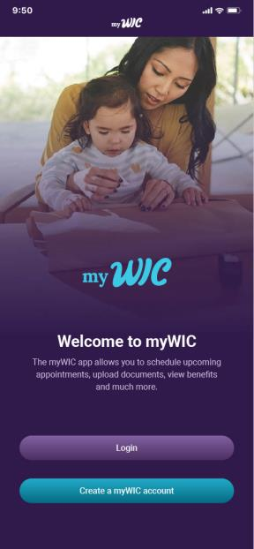
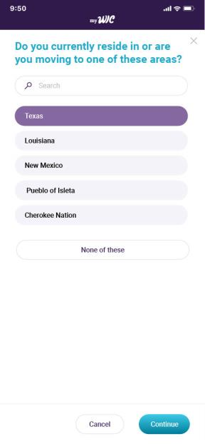
Notes:
Dallas users

Slide 29
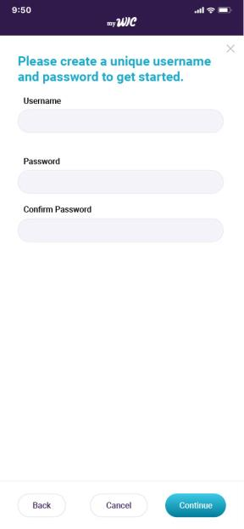
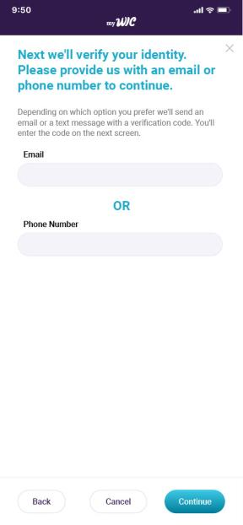
Notes:
Dallas users

Slide 30
Notes:
Dallas users

Slide 31
TXIN Portal Screenshots
Would love to schedule appointments & apply for WIC in an app
Looks “easy to use”
Looks like other apps
“
I like it. It looks familiar to any other app where you shop maybe like Target or Walmart, so it seems like it would be easy to use. You could just figure it out yourself. You wouldn’t be confused about what to do next on how to set up your account.
—–English-Speaking Interviewee
“
Notes:
Dallas users

Slide 32
“
It’s exciting to know that they have an app. What you showed me is personal & then this means that they’re going to be supporting the moms and the children. It’s more personalized because you create your own account, your own username & you create the questions in order to verify that you are who you’re saying you are. That gives me peace of mind because they are protecting my privacy & my personal information. I really like the colors. I love purple. So it was appealing.
––Spanish-Speaking Interviewee
”

Slide 33
Portal Look & Feel
“Modern”, “inviting”, & “pretty”
Like the colors
Several prefer this design over other Texas WIC materials – see it as an “update”
“
I feel like it looks a little more modern. Compared to like the app now, it seems a little more inviting, I guess. I don’t really know how to explain it, but it does look – I like the look better than the current app that they have, for sure.
—–English-Speaking Interviewee
“
Notes:
Dallas users

Slide 34
Portal Look & Feel
Several said they would question if this app was from Texas WIC because it doesn’t match WIC branding or say “Texas”
Several want to see “Texas”
When asked, several said they would trust the app even if it didn’t say “Texas” if their WIC staff told them to download it
Notes:
Dallas users

Slide 35
“
It doesn’t look like the traditional WIC lettering and stuff on that page. I guess they’re not as curvy – I don't know. It definitely– it looks newer. But I mean it is a new app, so if somebody hasn’t been on WIC for long, then they wouldn’t know that it’s not the original.
– English-Speaking Interviewee
I would know exactly which one because [WIC staff] would be telling me. I wouldn’t just be blindly looking for it in an app store wondering if it’s the right one or not. They’re giving me the information because it really is the app, so I would just download it.
– English-Speaking Interviewee
”

Slide 36
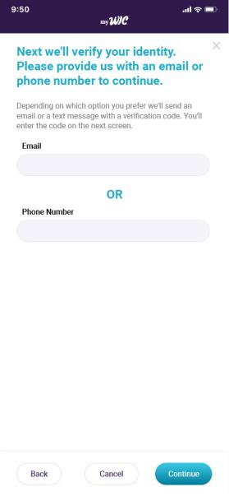
Providing Information
Similar to what other apps ask for – feel comfortable with it
Would expect to provide:
Date of birth
Email
Phone number
Address
Children’s birth certificates
Income information
Possibly Social Security Number
Possibly Medicaid information

Slide 37
What They Would Want to Know…
…Before creating a portal app account if they were new to WIC
What WIC could offer them - valuable services including food benefits, breastfeeding support & nutrition education
Eligibility requirements
How long the application process takes
What documents/info is need to apply
Notes:
Dallas users

Slide 38
“
I would like to know what WIC has to offer to me, their help whether in which way are they going to support me because this is a support for breastfeeding moms, for example. I would love to have the information and to let me know what the app is for and what is WIC offering.
– Spanish-Speaking Interviewee
I would want to know what the eligibility would be, how much income do I need to have or if I have other kids or things like that because I probably wouldn’t want to try to sign up if I don’t qualify anyway.
– English-Speaking Interviewee
”

Slide 39
How Long Would It Take?
To create an app account
To apply for WIC via app
5 minutes
15-20 minutes
Notes:
Dallas users

Slide 40
Applying For WIC
Not a point at which they would drop off, based on screenshots shown
What they saw was typical of other apps
“
The navigation is very self-explanatory. It’s very simple, so that’s good. Because you want something quick, because I know me, I like to get through all this stuff fairly quickly.
—–English-Speaking Interviewee
“

Slide 41
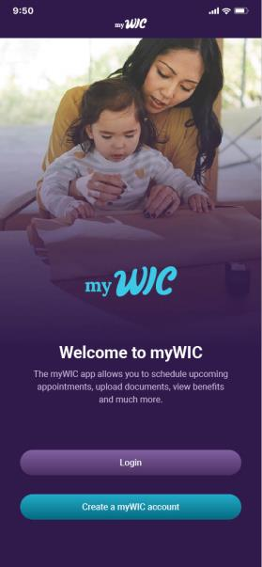
Real People
All prefer pictures of people who look relatable over illustrations
“
A real person. Because some people are a little bit, maybe embarrassed to use WIC or something like that. It just implies that it’s a real thing, real people use it, people just like you and I, normal everyday working individuals. She doesn’t look like poor or anything. She just looks like a normal woman.
—–English-Speaking Interviewee
“

Slide 42
Home Screen
Most Important Info to Include:
What users can do in the app
Schedule appointments, view benefits, apply for WIC
What benefits WIC offers for those who are new
Food assistance, breastfeeding support, nutrition counseling
Photo of mom and child
Eating healthy foods

Slide 43
Desired Push Notifications
Many want push notifications:
Want the ability to customize which notifications they receive
Upcoming appointments
Expiring benefits
Need to complete a class
New class available
Changes to the food package
Clinic closures
“Nutrition Reminders” didn’t resonate

Slide 44
“
Maybe when the days were getting close and you still have benefits left. Something like you have seven days to use these benefits before they expire or changes like if I hadn’t gone into the app and looked at the changes that they’ve made because of COVID, I wouldn’t know that I could get brown organic eggs instead of just the regular large white eggs. So, when changes happen like that, that would be nice.
– English-Speaking Interviewee
”

Slide 45
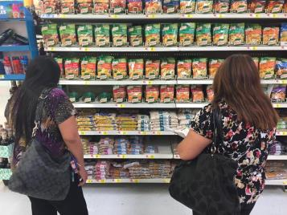
Learning to Shop for WIC
Most said “trial and error”
Many used Shopping Guide before the app was live
Several looked at shopping list
A few asked for help at store
A few said WIC staff helped
“
It did keep me from using WIC for a couple years when I could have been receiving it because it seemed really difficult at first, & I did have a lot of trouble in the beginning. When my 5 year old was first born, we didn’t receive WIC for probably about a year until she started eating just regular baby food because I knew I could get that, for sure, versus the other stuff which is hard to shop for. Now, it’s, with the app, it’s so much easier.
—–English-Speaking Interviewee
“
Notes:
Dallas users

Slide 46
“
They give you a paper when you go pick up your card & I went to the store & there was another young lady in there because she saw me struggling. It’s true, it wasn’t user friendly, of course. So, she told me about the app & it’s helped a whole lot because you're able to – I mean you see these little pink stickers & that helps but the app, you can scan products & see if it’s something that you can get & it’s been really beneficial & helpful. They also keep track of what you use & what you have available today.
– English-Speaking Interviewee
”

Slide 47
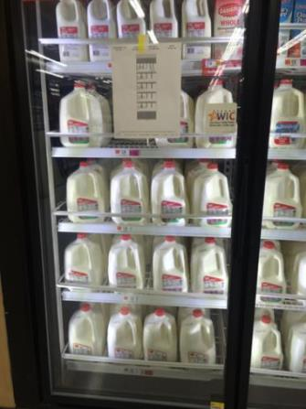
Pink WIC Stickers
Several look for pink stickers to guide their shopping
Notable number of interviewees think every WIC item is supposed to have a pink sticker
“
I think they’re supposed to label all of them, but I think there have been some items that haven’t said that they’re allowed. They don’t have the sticker on them, and I’ve been able to get them, but I don't think everything has been labeled.
—–English-Speaking Interviewee
“
Notes:
Dallas users

Slide 48
What WIC Staff Told Them About Shopping
Most were given a shopping list & Shopping Guide, but WIC staff did not tell them much – same in 2015
A couple were given tips about where to shop: avoid Wal-Mart, use the WIC-only store
“
They put the packet outside. You call & tell them that you're there & you put your information into an envelope & they pick it up off the table & then they bring the card & paperwork & put it in an envelope & set it on the table. You pick it up & so, no, I didn’t get any explanation.
—–English-Speaking Interviewee
“
Notes:
Dallas users

Slide 49
“
They honestly really don’t tell you much. They kind of just give you a list of your benefits and then that’s it. I haven’t really asked questions, though, to be honest, like what can I buy with it. I haven’t asked them for any help either at the office so it does go both ways, but you’re there waiting for a long time. Sometimes you have your kids with you who are probably tired of waiting, too, so you just kind of want to get in and out so you forget to ask those questions while you’re there.
– English-Speaking Interviewee
”

Slide 50
WIC Shopping Guide
All received it
Usually in a stack of papers
Most said staff did not open it or go over it
Several said it was helpful when they first joined to get their bearings
A few said they are “visual learners” and like the pictures
Notes:
Dallas users

Slide 51
Shopping Guide Vs App
Several said the app replaced the paper guide
Paper guide can be lost or left at home
Paper guide does not show specific allowed brands
“
I would try to keep that pamphlet back in the day with me so that I could figure out what to shop for exactly…it was hard to figure out what I could and couldn’t buy. I’d get up to the checkout & I’d have things that weren’t WIC-approved, versus now you can just use the app & it’s a million times easier to know what you’re shopping for.
—–English-Speaking Interviewee
“
Notes:
Dallas users

Slide 52
TexasWIC.org
Most have visited site only to take online classes
A few hadn’t been to the site
Did not report learning anything about shopping
Several want an online version of the Shopping Guide, indicating they aren’t aware what is on the site
One had watched shopping videos, found them helpful
Notes:
Dallas users

Slide 53
“
Those [videos] were extremely helpful, because they showed me different kinds of moms who are in different circumstances with their kids…they depicted each person shopping and then showing how to use the pamphlet, and it was just very hands-on and it was really easy…they gave me all the tips and tricks that I needed to start my own journey with WIC. I think the videos were relatively short too, which made that easier.
– English-Speaking Interviewee
”

Slide 54
myTexasWIC Shopping App
Many had used it & praised it
Helps determine the correct sizes & brands of WIC foods
Like My Benefits & barcode scanner
Those who hadn’t used the app said they want to use it
Eliminates need to carry paper shopping guide, shopping list, & receipts
Notes:
Dallas users

Slide 55
“
The first time I used [the app], I remember because I was like, “Wow, why didn’t they make this sooner?” because I remember I needed to know what I had and I would always – “What do I have? What do I have left?” – and then I never knew and I would just – when I would go grocery shopping nowadays, I buy SNAP or pay cash. It was more convenient because I would say, “Now, I know what to get, how much I have this” - I would just go inside the store and get it.
– English-Speaking Interviewee
”

Slide 56
“
It helps quite a bit. Well, like I said, it did just address the fact that I would like to know what brand. I know what I can get now, I know what size, and stuff like that. I just need to know which brand and from what store to make the process a lot faster.
– English-Speaking Interviewee
Instead of getting all these papers from the WIC office, with this app, you wouldn’t even need to get the receipt. Afterwards, they always ask you, “Do you want your receipt?” and I say, “Yes”, because that’s the only way to tell next time what I have on there.
– English-Speaking Interviewee
”

Slide 57
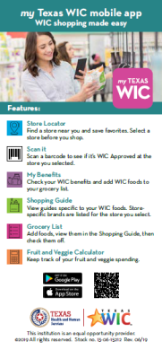
myTexasWIC Shopping App
Several heard about it via flyer from WIC
One or two interviewees said:
WIC staff told them about it
Heard about it from study recruiter
Searched the App Store assuming their would be an app
Heard about it from a friend
Another WIC shopper saw her struggling and told her about it
Notes:
Dallas users

Slide 58
App Flyer
Several had seen it before
All liked the design, list of features
Suggested WIC make a similar flyer to promote the portal app
“
When I was looking for this app, I wasn’t too sure if it was the correct one. I think there might have been another one & I downloaded it by accident & it wasn’t the right one until I found this one. I know that it was a little bit hard for me to find it, but this looks really specific & with the QR code, it’s even better.
—–English-Speaking Interviewee
“
Notes:
Dallas users

Slide 59
Other Shopping Apps
Half use other shopping apps
Mostly for grocery store chains
H-E-B, Walmart, Target, Kroger, Safeway, Albertson’s
Mostly for sales and coupons
One liked that other apps show her “favorites” = frequently bought items
Notes:
Dallas users

Slide 60
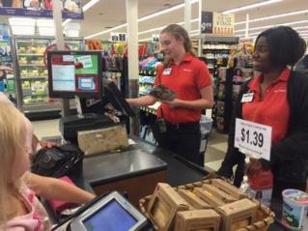
WIC Shopping Experience
Several said it takes time to get a handle on shopping
Between 2 & 5 shopping trips to feel confident
Initial trips include bringing wrong items to register
“
At the beginning is that it was hard because I would get to the cash register & I would be sent back because some products would not be included in the benefits, & now I have identified them better. Sometimes even though those items are included in the guide, some grocery stores would reject those items.
—–Spanish-Speaking Interviewee
“
Notes:
Dallas users

Slide 61
WIC Shopping Experience
Despite describing difficulties choosing approved items, several said it’s “pretty easy” once they learned which items will scan
A few buy the same items each time to avoid choosing non-approved foods
A few go to the WIC store
“
Sometimes, when I have all my children, I can’t go in the store, I’ll go to the [WIC-only store] drive thru because it’s more convenient. More stores need to have like an aisle or something that says “You can get this with WIC”, instead of having to find out what is okay to get and what’s not okay.
—–English-Speaking Interviewee
“
Notes:
Dallas users

Slide 62
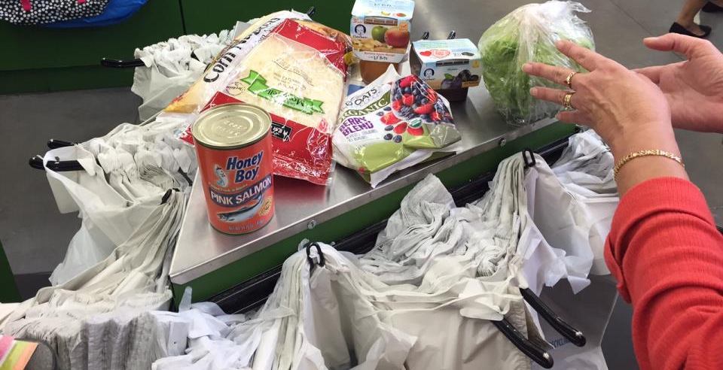
WIC Shopping Challenges
Many said choosing correct brands & sizes
Several described feeling nervous at the register
Embarrassing to be denied
“
It’s a little bit embarrassing if you don’t have the right item and they have to take it off because they have to clear out your entire ticket one by one. It’s not just zero out, they have to do it one by one. So, it’s time-consuming sometimes because it’s like, “Crap, I grabbed the wrong bread.”
—–English-Speaking Interviewee
“
Notes:
Dallas users

Slide 63
Making Shopping Easier
Most interviewees said shopping for WIC items is fairly easy because they are now experienced
Several said myTexasWIC app has already improved their shopping experience
“
Honestly, I don’t really know. I enjoy having the app to double check things to make sure I have everything I need before I’m done shopping but that alone is just enough help to be able to buy my things.
—–English-Speaking Interviewee
“
Notes:
Dallas users

Slide 64
What You Wish You Had Been Told
…about shopping when you first joined WIC
Can only buy certain brands & types of food
Double check the sizes
Use the app & shopping guide to learn what is approved
Would tell new clients to go to the app to learn about WIC shopping
Notes:
Dallas users

Slide 65
“
I would tell them to make sure they got the app, because for me, if I would have had that app, I could have saved myself a lot more time, a lot more frustration. Now, like you said, I’ve had [WIC] for almost five years, so I can pretty much navigate through it a lot easier nowadays, but with somebody new, they’d definitely want the app to save them the time and the stress. Because I’m telling you, there were times I just wouldn’t even want to use it, but I was like, “I have to.”
– English-Speaking Interviewee
”

Slide 66
Shopping Classes
Would want to learn which foods they can buy with WIC
A few said healthy recipes
Many said texts would be the best way to advertise classes, email was second choice
“
I guess I would just want to know what types of products you can buy, maybe they’ve added a new variety that you didn’t know about or something like that. I definitely think it would be helpful for someone new coming to WIC to take a class like that and be able to see what you can get at the store and know what all your options are ahead of time.
—–English-Speaking Interviewee
“
Notes:
Dallas users

Slide 67
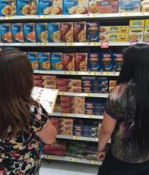
Improving the Shopping Experience
Most said shopping is pretty easy, especially with the app
A few wished WIC items could be better marked or grouped together – top response in 2015
“
Make sure that their WIC stickers are on, like to just probably have a person go out, a WIC agent go out to the stores and maybe somebody in the WIC office, who just to want make some extra money that will go out to the stores and just make sure that their items are being marked. Because there’s even like really pregnant women that need their WIC items and it’s hard.
—–English-Speaking Interviewee
“
Notes:
Dallas users

Slide 68
Round two Interviews
N=15
10 English
5 Spanish

Slide 69
myTexasWIC App Exploration
Sent on shopping trip to use app features
Choose the image that represents how they felt about their trip
Several said easier than usual because of features new to them
Several had “ups & downs” using app/ features for the first time

Slide 70
“
I found it easier to move around the store. I didn’t have to look for the label or the ticket because I have the list of my benefits. I didn’t have to go to cashier to ask for my benefit & I didn’t have to be looking around what brands I needed.
– Spanish-Speaking Interviewee
I will say, like I said, the grocery list simplified things. So, I think it may cut – it may have cut down on just a little bit of time since I didn’t have to go back and forth between apps. I would say overall, a more pleasant experience.
– English-Speaking Interviewee
”

Slide 71
myTexasWIC Shopping App
Most had used the app before
Most discovered a feature that was new to them on the trip
No issues downloading or registering account
Weak cell signal in stores = only occasional tech issue
“
It was simple because the WIC office gave me the form and told me where to go and what to click on to get in and just download it on my phone.
—–English-Speaking Interviewee
“
Notes:
Dallas users

Slide 72
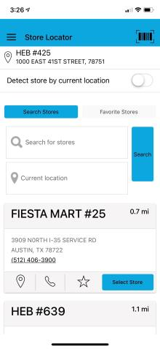
Store Locator
Many gave it “thumbs up”
Several said the “detect location” option works perfectly
A few learned about stores near them they didn’t know accepted WIC
A few said it would be helpful when shopping at new stores
“
It knew where I was before I even selected my store. Generally, if I pull up the app, it will just automatically – it gives me the closest store near me.
—–English-Speaking Interviewee
“
Notes:
Dallas users

Slide 73
Store Locator
A few had issues finding their store
Some did not realize the app displays specific items after choosing a store
Suggestions for improvement:
List stores by distance (closest to furthest)
Filter by grocery store chain
Search for stores by ZIP code
See stores on a map
Notes:
Dallas users

Slide 74
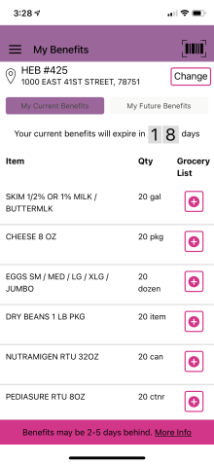
My Benefits
Most gave it “thumbs up”
Feature most likely to have been used by interviewees before
Seen as improvement over keeping up with receipts & going to register, especially during COVID
“
It was the most useful because, like I had already mentioned to you before, I kept my ticket with me or I had to go to the cashier to ask how many benefits I still have left. This was wonderful because it had my benefits in actual time.
—–Spanish-Speaking Interviewee
“
Notes:
Dallas users

Slide 75
My Benefits
A few did not realize clicking the plus sign adds items to grocery list
Most frequent wish for improvement = reflect changes in benefits automatically, no lag
“
Make it easy, accessible to see what you’re able to get because like I’ve messed around with this app a bunch of times, and I didn’t know that you could do the plus sign and get there from the grocery or making a grocery list. I feel like it should be easier because I mean, I went to the app so many times, and I didn’t know I could do it.
—English-Speaking Interviewee
“
Notes:
Dallas users

Slide 76
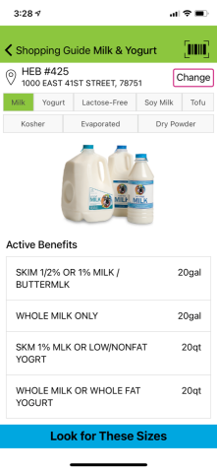
Shopping Guide
Many gave it “thumbs up”
Improvement over paper version = shows specific brands & cannot forget it at home
Most had used it before
“
I think the shopping guide is pretty solid in terms of being able to navigate it and understand it and work through it. I wouldn’t change anything. It’s solid.
—English-Speaking Interviewee
“
Notes:
Dallas users

Slide 77
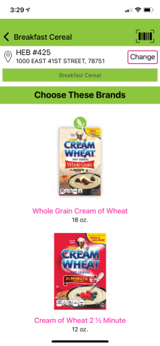
Shopping Guide
Suggestions for improvement:
Several said include pictures of branded packaging like the cereal section
Ensure items listed as “approved” on guide are approved according to that store
Ensure items listed in guide are available at that store
Notes:
Dallas users

Slide 78
“
I know you can scroll down and see what brands and everything, but if you could click on those and see what brands. It would be even cooler if you could do pictures, but I know that would be hard for every store.
– English-Speaking Interviewee
Maybe if - really elementary, but even something as simple as like the cereal, they have the picture of what it is that you can get. That’s easier to glance at. It’s just easier to read & visualize versus looking at, like I said, the yogurt, and you have to scroll the list & then look at the cartons to see what matches you.
– English-Speaking Interviewee
”

Slide 79
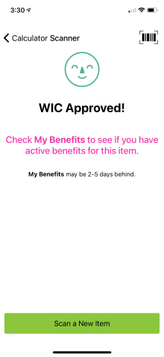
Barcode Scanner
Half gave it “thumbs up”
Feature most likely to have not been used by interviewees before – did not notice it or realize what it was for
“
No. I didn’t even know. I didn’t really pay attention to that feature. No, it was fine. It just gave me the same information that the store was providing. But if I were to forget or something like that while I have it in the basket, I could check it with the barcode scanner.
—English-Speaking Interviewee
“
Notes:
Dallas users

Slide 80
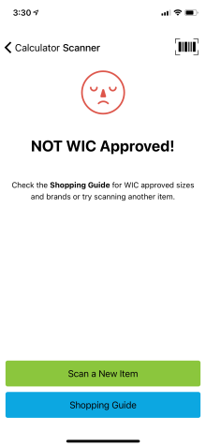
Barcode Scanner
Many said they would use it again, specifically if they went to an unfamiliar store or the store was out of their normal brand
A few had issues where the scanner was not accurate
“
One time I tried to get yogurt, and they list what kind you can get, and I scanned the yogurt on the scanner part to make sure it was WIC approved, but I went to buy it, it didn’t take it off the WIC, so I don’t know what was different.
—English-Speaking Interviewee
“
Notes:
Dallas users

Slide 81
Barcode Scanner
Suggestions for improvement:
If items scans as “not approved” because it is the wrong size or flavor, it would be helpful to get that explanation
Should say “approved” only if item is included in the user’s specific package
“
Because I know I can get 48 [ounces], I think if I scan something that says 64, maybe it should like kind of tell somebody that that’s not what you’re approved for or something.
—English-Speaking Interviewee
“
Notes:
Dallas users

Slide 82
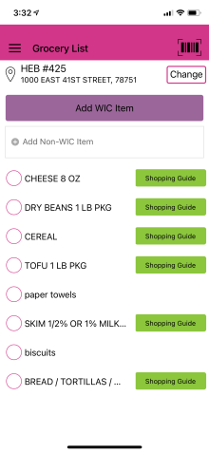
Grocery List
Half gave it “thumbs up”
Half had not used it before
Several do not use lists
Several use their Notes App
A few didn’t realize they could add non-WIC foods
“
It’s convenient. Like I said, instead of having to write everything down, it’s just there on my phone.
—English-Speaking Interviewee
“
Notes:
Dallas users

Slide 83
Grocery List
Suggestions for improvement:
“Favorites” list
Write in specific brands & sizes
Make it clear when item has been added to list
Separate categories like pasta and bread to be checked off individually
Notes:
Dallas users

Slide 84
“
When you actually go down the grocery list, if you have three pounds of like pasta, bread, oats, those are all in the same line. So, I don’t know if you’re going to collect all of those things at once, because they’re on different aisles throughout the store, and I don’t know if it would be easier to have like a little sub [menu] underneath each one to like say, “Okay, I’ve got this pound. I’ve got this pound. I’ve got this pound.”
– English-Speaking Interviewee
”

Slide 85
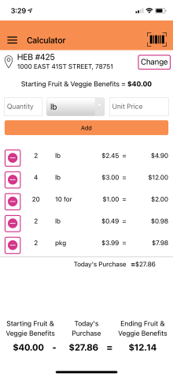
Fruits & Veggies Calculator
Half gave it “neutral”, several gave it “thumbs up”
Several had not used it before
Half would use it again
“
That was an upside because I didn’t know that it kept track of what your actual benefits are and so when you put your produce in there, it subtracts and lets you know how much of your benefits you’ve used. I didn’t know it did that. I thought it’s just like a calculator, regular calculator.
—English-Speaking Interviewee
“
Notes:
Dallas users

Slide 86
Fruits & Veggies Calculator
Most are fine with going over their allotted benefits, so had not been motivated to try the feature
A few said they can keep track of $11 in their head
A few said its “too much” to use in a busy store, were confused about entering weights
“
I think, because I just knew that I had $11 on my benefits & I would just grab what I needed & usually, at least $11 or more, so I really didn’t calculate anything.
—English-Speaking Interviewee
“
Notes:
Dallas users

Slide 87
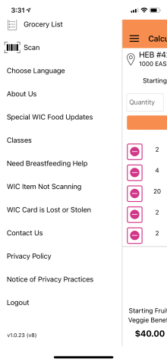
App Menu Exploration
Most had not noticed these links
Wished they had seen them because they could have used the resources
A few did not realize they could keep scrolling
“
Now that I’m seeing them, very helpful. If I was using this app again when I was pregnant, the classes & the need help breastfeeding, definitely would have used those two & the lost and stolen because I lost my card religiously when I was pregnant.
—English-Speaking Interviewee
“
Notes:
Dallas users

Slide 88
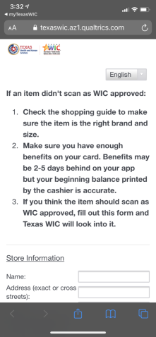
WIC Item Not Scanning
One had clicked this before
Several expected in-store troubleshooting tips
A few wondered how long it would take for WIC to get back to them or how it would help them during their trip
Notes:
Dallas users

Slide 89
“
That process is hard and tedious. They want pictures of the barcode. They want pictures of the product, and they want your card number. So, I think I would be more willing to help them out if I didn’t have to submit my card number every single time, because, if you do something wrong in that process, it’s hard, because you have to go back and redo the whole thing.
– English-Speaking Interviewee
”

Slide 90
WIC Item Not Scanning
A few would use the form now that they know about it
A few would not bother – form seems long & they would just not buy the item
Fine with uploading pics but user may not know they need pics
“
It’s good, but I don’t know if everybody would be able – I guess you’d have to take a picture of it before you leave. I don’t think everybody would know to take a picture before they go because if they can't afford it, then they’re going to put it back.
—English-Speaking Interviewee
“
Notes:
Dallas users

Slide 91
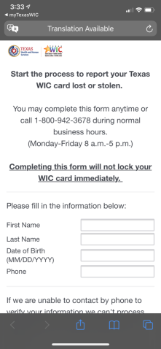
WIC Card Lost or Stolen
Form looks quick – no suggestions for improvement
Most like the idea of reporting a card lost on the app vs. calling
“
Exactly what I thought it was going to be. Just my name, first and last name, date of birth. They’ll log the card. Yes. It says we can’t contact you by phone, you can be contacted by email. Unfortunately, if I had a time in life I didn’t have time to keep my phone on, I can still talk to them through email and still get food for my child.
—English-Speaking Interviewee
“
Notes:
Dallas users

Slide 92
Design Preferences
Several liked the look & feel, colors
A few called it “basic”, “dated”, said the colors are “childish”
“
I think it’s good. I think it’s fitting. I like the colorful on the homepage like the green shopping bag and all the colorful things, and I think it’s good.
—–English-Speaking Interviewee
A combination of 2 or 3 colors at the most. There are too many colors there. It looks very childish. Honestly, the kids are not the ones using the app. I would like it if it would be designed for me.
—Spanish-Speaking Interviewee
“
Notes:
Dallas users

Slide 93
Layout Preferences
Like the “big button” layout
Give the barcode scanner it’s own home screen button
“
I actually kind of like it with the big buttons like that. Like I said, the one thing I would change is that little barcode scanner. Maybe add that to those buttons instead of having it like in the corner because the barcode doesn’t stand out with everything else. It’s not really color-coded. It’s not a big colorful button like everything else is.
—–English-Speaking Interviewee
“
Notes:
Dallas users

Slide 94
App Tutorial
Many had not been aware of all major features
Many requested in-app tutorial and/or video tour
Suggestions:
Pop-up in app when something is added
Push notifications spotlighting features
Texts with helpful tips about using app
Have WIC staff walk users through app when they first download it
Notes:
Dallas users

Slide 95
“
How some apps you’ll go on there, and it’ll have, “Here’s a beginner’s tutorial,” and then I’ll go through the steps like, “Here is where you’ll find a shopping guide. Here is where you can scan,” and then just basically a walkthrough tutorial and then keep it to where you can always do it.
– English-Speaking Interviewee
”

Slide 96
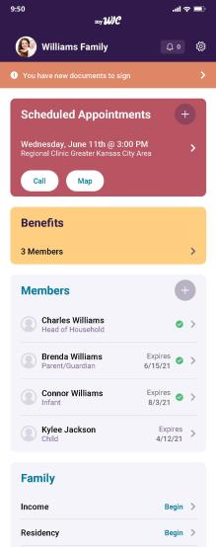
Portal Home Screen
Seems “simple”, “convenient”
A few said they liked the look and feel more than the current WIC app, seems more “modern”
“
That looks a lot better than the current app. It just looks more up-to-date. The flags that you have, documents to sign right away. Yes, that looks a whole lot better. It looks more like a total WIC app versus a shopping app like the other one just looks a shopping app to me.
—–English-Speaking Interviewee
“
Notes:
Dallas users

Slide 97
Portal Home Screen
Looks familiar, like other apps
Several like “appointments” up top
“Members” & “Family” could go in side menu, not needed every day
“
Yes, it’s very well-organized. It’s what you’re usually being asked for, all this information, your family members, the income. It looks like they’re similar to any other, the residency, your address. I would use it. I would have it on my phone.
—Spanish-Speaking Interviewee
“
Notes:
Dallas users

Slide 98
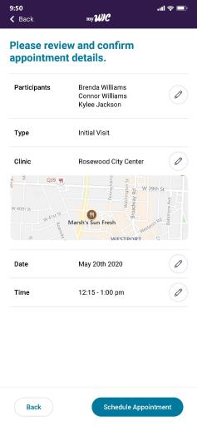
Appointment Scheduling
Many said process is straightforward
Several want to know what to bring to each appointment (child, paperwork, classes)
Better than being on hold
“
I think scheduled appointment is very accurate and it’s really good. Then you might put on underneath or within the scheduled appointment, make sure that you take a class online or what are the requirements for that scheduled appointment.
—English-Speaking Interviewee
“
Notes:
Dallas users

Slide 99
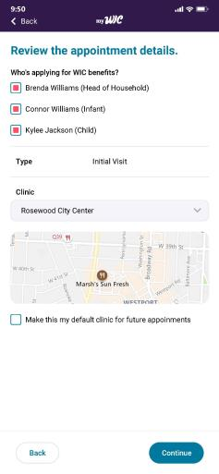
Choosing a Clinic
Expect app to find closet clinic automatically or type in ZIP
A few could not find their clinic by name on a dropdown list
“
Automatically detect where you are and then also you should be able to search by either ZIP code or city or something; mostly ZIP code but definitely not the name of it because that would mean absolutely nothing to me if I’ve never been there before.
—English-Speaking Interviewee
“
Notes:
Dallas users

Slide 100
Combining Apps
Want shopping tools button under appointments – goes to reskinned myTexasWIC home screen
“
I think that the features of the actual myTexasWIC, I think that’s the one that we’re going to use the most. They would go on the home screen page, for example, to schedule an appointment or members of the family or change my income. It would be something that I would use every time I open the app.
—Spanish-Speaking Interviewee
“
Notes:
Dallas users

Slide 101
Ideal Home Screen
“Appointments” at the top
“Shopping Tools”
“Benefits”
“Classes”
Notes:
Dallas users

Slide 102
Round three Interviews
N=15
10 English
5 Spanish
WIC clients < a year

Slide 103
Applying for WIC
Most frequent response was do as much of it online as possible
Online = easier than over the phone & less time in office
Office visits can be stressful with children & COVID
“
I don’t think they do that online, but if they can do it online, especially - because when I went, he was so small, and he was just out there with everybody in the room. There were two sick babies in the office where we were waiting. It just, I guess, exposes him to a lot of things. Well, any kid actually. Honestly, I think if they did things online.
—English-Speaking Interviewee
“
Notes:
Dallas users

Slide 104
Online Application Process
Half applied online & couldn’t think of any improvements
Process was easy, especially compared to other programs
Called in 1-2 days, seen in 1-3 days
“
I had to fill out my application online, and then they called me, and she told me some things I needed to send in like my ID and proof of address. Once I sent that, it was really fast. I can see where it may be difficult for people that don’t have access to the internet, or maybe it was different pre-COVID whenever you had to go in and out of the office a lot. Since I just did mine in September, everything was online, and it was pretty easy.
—–English-Speaking Interviewee
“
Notes:
Dallas users

Slide 105
How Did You Hear About WIC?
Most heard from friends & family
Several were told by their doctors to apply when they found out they were pregnant
“
Just from my sisters. They’ve had kids, so they told me that I needed to apply for WIC. They all said they’ll help me get milk & anything I needed for the baby.
—English-Speaking Interviewee
My mom, she actually told me about WIC because my sister, she went through WIC. She breastfed her child for 24 months. I was trying to breastfeed my child.
—English-Speaking Interviewee
“

Slide 106
What catches their attention about online ads:
Babies and moms
Bright colors
Catchy music
Humor
Video

Slide 107
Half remembered WIC Facebook ads:
Qualifying for WIC
Hispanic mom & cute baby with a lot of hair
Colorful food pics
Happy people shopping
Relatable moms & babies breastfeeding, not models
WIC offers breastfeeding help

Slide 108
“
I remember I was just scrolling, and then you see “WIC supplemental assistance” I think it said, and I had never clicked on it because I had already received it. I think that’s one of the things that our phones do. If we start searching something, then it’ll pop it up on our Facebook. I had already qualified for WIC before I ever saw an ad, but previously to applying, I didn’t see anything.
– English-Speaking Interviewee
”

Slide 109
WIC Ad #1
Several had seen it
Like that it explains what WIC offers
Organic cereal & breastfeeding support stood out
“
I like it. I like that they explain what is offered with WIC. It gives a lot of information what exactly goes with WIC. So, I would definitely, I mean if I wasn’t with WIC, I would definitely apply knowing that they provide all of that information.
—English-Speaking Interviewee
“
Notes:
Dallas users

Slide 110
WIC Ad #2
A few had seen it
Like that it includes real dollar amount
Like seeing grandpa
Would like to see income for various family sizes
Expect to go right to application form
Most said ads had important info
A few suggested bullets
Notes:
Dallas users

Slide 111
Where They Expect To See Ads
Facebook
Instagram
Many
Several
Pregnancy Tracker Apps
Pinterest
Twitter
Few
Notes:
El Paso gen

Slide 112
Facebook Use is Prevalent
Many are in mommy Groups
Share parenting tips & get support
Groups = good place to promote WIC
New moms who don’t know about WIC
“
We actually post encouraging things for each other, happy things. I just actually posted that my baby is walking. We post things about breastfeeding. I know that a lot of moms that also get on the website and offer breastmilk if anyone has children and they’re not able to produce milk anymore. Yes. We have a lot of women on our thing there. It’s a great group.
—English-Speaking Interviewee
“
Notes:
12 minutes
Women like themselves, trusted source,

Slide 113
Where Should WIC Advertise?
Because WIC is so helpful for families, they should advertise on any & all platforms
Half use Snapchat and Tik Tok – mostly see ads for games on those apps, but WIC should have ads there to reach younger moms
“
For those mothers that don’t know about the breastfeeding & nutrition counseling, things that will benefit the baby, I think that will help them in so many ways. Seeing these ads out everywhere & people reaching out to them, I think it’s a good thing.
—English-Speaking Interviewee
“
Notes:
12 minutes
Women like themselves, trusted source,

Slide 114
Team Up With Influencers
Influencers could encourage more people to sign up, reduce stigma & are more compelling than static ads
Half said Facebook & Instagram, several said YouTube & Tik Tok, one said Snapchat
Half would follow an influencer that talks about WIC – healthy recipes, funny skits
“
If somebody is physically talking about it, I would definitely want to get more information about it because I would think it’s real and I would want to sign up.
—English-Speaking Interviewee
“
Notes:
12 minutes
Women like themselves, trusted source,

Slide 115
“
This day and age, a lot of people are into social media so I think that would be a way to get it out there more. Yes. It would be a way to get it out there more, and I know I’ve probably – in my part of the country anyway, government assistance is looked down upon a little bit, and people are a little embarrassed about it so maybe that would open it up a little bit more to not be so ashamed.
– English-Speaking Interviewee
”

Slide 116
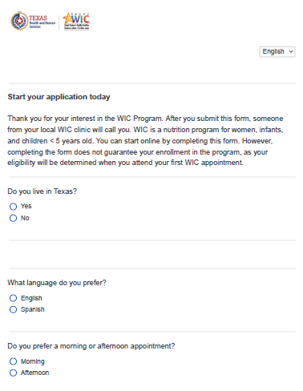
Online Application
Half had seen it
Seems easy to complete
Length is “just right”
Most would not want to remove any questions
Easier than the office – especially during COVID
Want to fill it out at once, but want to save progress & return later if needed
Notes:
Dallas users

Slide 117
Client Perceptions
“Have you been on WIC before?”
SNAP, TANF, or Medicaid Information
A few worried they may be denied if they had WIC in the past
When asked, others thought it was just for informational purposes
Several wondered if they would be denied or offered less WIC benefits if they are on another program
But, many would gladly share that info if it made their WIC process faster
Notes:
12 minutes
Women like themselves, trusted source,

Slide 118
“
That’s actually very easy. That pretty much asks you everything. I like the fact that it asks you for your zip code to point you to the nearest WIC location and then the phone number so they can call you to schedule it. Well, I’m not going to lie, it would be nice to have the option to schedule it yourself like have an online scheduling where “Here’s the openings” and you can click this like let’s say for Wednesday at 10:00 in the morning. That would be actually really nice but overall, the application itself is pretty seamless.
– English-Speaking Interviewee
”

Slide 119
Scheduling Appointments
Many prefer to schedule online instead of waiting for a call
Don’t always answer calls – busy moms & don’t pick up unknown numbers
Missing calls could delay benefits
10-15 minutes
“
You never know the person’s situation. They might have an emergency. They might need to get into WIC soon and not wait three days, four days, or however long that they take to call you. So, I think it’d be a lot better if the client, the person could choose their appointment time.
—–English-Speaking Interviewee
“
Notes:
Dallas users

Slide 120
TXIN Portal
Many were enthusiastic about a portal app, saying it would make their lives easier – a couple mentioned the My Texas Benefits app
Top Desired Features:
Schedule & view appointments
View food benefits
Upload documents
List of WIC-approved foods
Take classes

Slide 121
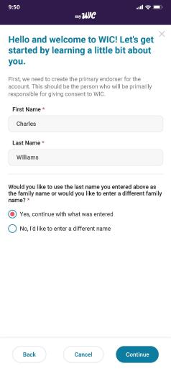
Portal Sign-Up Process
Seems “easy”
A few said is seems up to date and like the colors
No concerns creating account before filling out family info
“
I think it all seem quick. The letters at the top or the big ones in blue, those are easy to read. Then, they know what’s coming. Then, you read in the black the specific directions. Yes. I think it seem pretty quick and easy.
—–English-Speaking Interviewee
“
Notes:
Dallas users

Slide 122
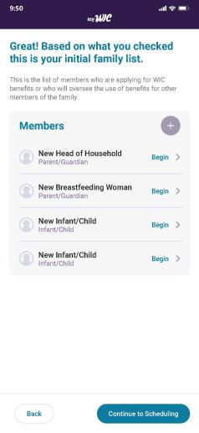
Family Access to Portal
Many like the idea of family having access to help with shopping
A few want family to schedule appts
Do not want them seeing income, Medicaid, or SSN
“
That would be nice because sometimes like when I have my baby and I’m not going to be able to do it myself, my significant other can like, “Here you go and you need to go get this stuff. This is how you do it.”
—–English-Speaking Interviewee
“
Notes:
Dallas users

Slide 123
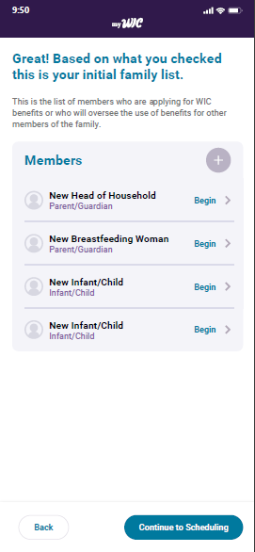
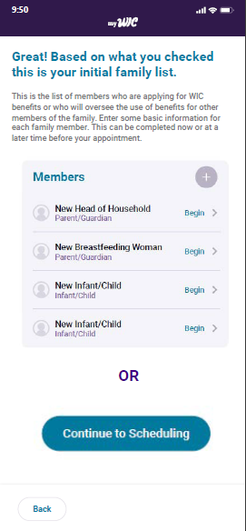
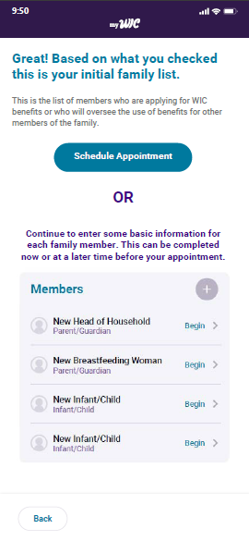
Screen Comparison
A
B
C
Notes:
Dallas users

Slide 124
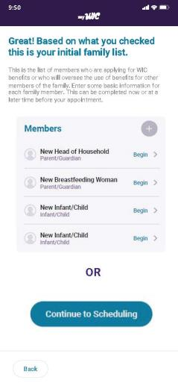
Screen Comparison
B
Most popular = B
Best conveys that users can either fill in member info or schedule appt
“
If I was to apply for anything, I would like to see it big and bold and basic. I don’t want to squint and look at words or accidentally hit something that I’m not supposed to hit from it being small or everything so much together. I would like for everything to be like this, spaced out.
—–English-Speaking Interviewee
“
Notes:
Dallas users

Slide 125
WIC Shopping Education
First appt = good experience
Several waited in their cars, a couple over the phone
Stack of papers
Several said staff didn’t say much about shopping
“
Maybe somewhere else they might but here in Laredo, they just basically give you the card and, “Here, put your PIN in this little machine.” You put your PIN, and they gave me the card, and said, “Here you go. You’re good to go,” then that’s it. They didn’t explain to me about the shopping, they didn’t explain to me anything at all. Not about that at least. Everything else, they were informative, but not that.
—English-Speaking Interviewee
“
Notes:
Dallas users

Slide 126
How Clients Feel About WIC Shopping
Half described trouble shopping
Looking for pink stickers, nervous about choosing wrong item
Several had troubles at first, but overall have good shopping experiences
Notes:
Dallas users

Slide 127
“
Because the first time I went, all my stuff is wrong, all my stuff. I was so confused on how to do it because most of the stuff wasn’t marked, what was WIC, what wasn’t WIC and I was just so confused.
– English-Speaking Interviewee
In the beginning, it was hard because some stores do it one way, some stores do it the other way. I’ve got there and sometimes it’s any item, sometimes it’s that particular item, and that was probably me at first. So I can say now that I am happy and satisfied. So I can say that I can either be a 10 or a 20. He’s smiling.
– English-Speaking Interviewee
”

Slide 128
WIC Stores
Several said their WIC shopping experiences are positive because of the WIC store
Advantages:
Drive thru
Staff brings groceries to car
Staff checks for unused benefits
“
That’s exactly why I do the WIC drive-thru, because it’s always there, & you just go and pick up everything that they have. Because of the kids, I can’t really do much with them, being in & out, being lost, finding the stuff. Sometimes they move them around.
—–English-Speaking Interviewee
“
Notes:
Dallas users

Slide 129
Improving the Shopping Experience
Several said improved signage at the store
Several said there should be a WIC food section at the store
More foods & variety of foods
“
To just have an aisle specifically for WIC products on the grocery store because I know that there are WIC shops specifically for WIC items but they are not close to where I live. So maybe if in the grocery stores, they could have an aisle with only WIC products.
—Spanish-Speaking Interviewee
“
Notes:
Dallas users

Slide 130
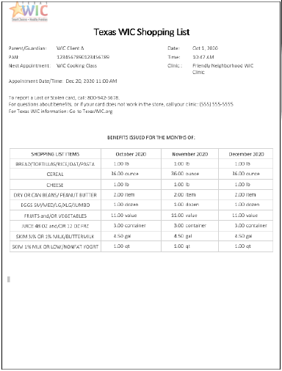
Shopping List
Most had received it
Helpful because it lists specific amounts, though those are confusing at first
Must cross reference with guide
Several said shopping app has replaced it
Notes:
Dallas users

Slide 131
WIC Shopping Guide
Most received it
Several said it was helpful, like the pictures
Several said not helpful – doesn’t have details about brands
“
The app has definitely replaced that manual shopping guide that you have to kind of pull out. In frustration, I’ve walked into the store and had to go walk right back out because I left it in the car door or something. So knowing I'm always keeping my phone on me, that was a very good replacement for it.
—–English-Speaking Interviewee
“
Notes:
Dallas users

Slide 132
myTexasWIC Shopping App
Best tool for shopping
Many had used the app before
“Helpful”, “specific”, “fast”
Makes checking benefits easy
A few heard about it from WIC
A few heard about it from study recruiter
One said WIC staff had her download it at her first appt
Notes:
Dallas users

Slide 133
WIC Shopping Video
One had seen a shopping video – WIC staff asked her to come to the clinic & watch it after she told them she had trouble shopping
Most were not aware of it
Would want to see it before first shopping trip
“
That probably would have been helpful though because I felt like I was going in blind.
—–English-Speaking Interviewee
“
Notes:
Dallas users

Slide 134
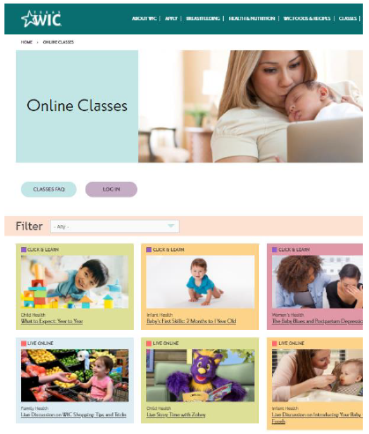
WIC Shopping Classes
None had taken one
Most were not aware
Several said online classes are appealing – don’t have to go to office
Would want to take it when they first join
Notes:
Dallas users

Slide 135
Texts From WIC
Right after first visit – go straight to the grocery store after getting WIC card
Link to download app
Link to shopping classes
Guidance on what foods to buy
“
That would be helpful because like I said, I just found out about that [app] a week ago. It might help somebody else too. I mean, it got me extra milk & cheese & a couple of extra vegetables that I didn’t know I had, so it might help somebody out.
—English-Speaking Interviewee
“
Notes:
12 minutes
Women like themselves, trusted source,

Slide 136
WIC staff could better prepare them by:
Promoting the app
Promoting the classes & videos
Explaining what brands & sizes to buy
Telling them about the pink stickers

Slide 137
“
It’s like a customer service thing. “Did you know about, this is how we shop? Let me hold your hand while we go through this stuff, what this entails for you.” I didn’t really feel like anything like that really happens. Maybe it’s just a disconnect because of COVID, everybody kind of figured out new ways to do things. I don’t know how if it would be different if I saw someone in person, I felt like it was real short.
– English-Speaking Interviewee
”

Slide 138
WIC Shopping Support
Half want staff to follow up throughout the month to assist with shopping
Half said via text, a few said email
Many want tips via text once a month
“
Maybe if it was an optional kind of thing like a text halfway through the month, “Would you like help spending your benefits this month?” I don’t know if there’s a way if they can see you already used your benefits in the month. If it gets maybe towards the end of the month & they noticed that you haven’t used them yet & they’re like, “Is there a reason you haven’t used them yet? Do you need help learning how to use it?”
—English-Speaking Interviewee
“
Notes:
Dallas users

Slide 139
WIC Shopping Facebook Group
Many would join
Appreciate support from Groups
Want to hear tips and trick from real WIC shoppers
“
Just because it’s a real person, you can kind of talk to them. I’m constantly in a group and kind of checking comments and trying to see what little tips and tricks I see and I go and try them. So it’d probably be an easier, kind of fast way to get information as well. I'm always on Facebook. I can catch that better than taking the time to go read something else.
—English-Speaking Interviewee
“
Notes:
12 minutes
Women like themselves, trusted source,

Slide 140
Leftover Food Benefits
Many have benefits left each month
Those who do not go to the WIC store
Several have benefits left because they do not eat the quantity given
A few have benefits left because they can’t find the approved brand or size
Notes:
Dallas users

Slide 141
Baby Food: Jars vs Fresh
Most frequent response = “half and half”
Want more benefits for fresh fruits & veggies, but convenient to have some jars
Give clients the option
“
I think that maybe it should be an option for the mom to choose because it might not be something that everybody is into or interested in or have the time for. I have one kid now and I can actually take time and prepare his meals but if you maybe have four kids and everyone has a different need.
—English-Speaking Interviewee
“
Notes:
12 minutes
Women like themselves, trusted source,

Slide 142
New WIC Foods
Greek Yogurt
Swiss Cheese
Muenster Cheese
Several did not know “Muenster” so they were neutral about it
Most are fine with adding fish pouches
Half eat tuna or salmon – some cans, some pouches
Notes:
Dallas users

Slide 143
Closing Thoughts
Shopping App = Revolutionary Tool
In 2015, 75% were “very likely” to use a WIC shopping app
In 2020, enthusiastically adopted
Offers more assistance than ever
Addresses primary concern of choosing the right brand & size
Hard to forget at home
Notes:
Dallas users

Slide 144
Closing Thoughts
Ready for the next game changer
Enthusiastic about scheduling, document uploading, & applying on an app
Want to stay out of the office (COVID) & off phone calls
2015: 44% said wait time at the office was the most difficult part
“Modern” & “inviting”
Notes:
Dallas users

Slide 145
Recommendations: Staff
Consider mandatory shopping training module for all staff. Require staff to shop at local store.
Explore education opportunities for clients to become more familiar with the WIC shopping experience before their first trip
Text the link to the shopping video, the MyTexasWIC app, & the online shopping classes
Continue to explore opportunities to train staff on food package changes
Notes:
Dallas users

Slide 146
Recommendations: Training
Make sure staff understand that not all WIC-approved foods in the store will be marked with a pink sticker
They need to communicate this to clients
State WIC should provide a refresher course on the MyTexasWIC demo app & leave it online for new staff
Staff should ask WIC clients to download the app at their first appointment & explain the main features
Point out that the Shopping Guide is different for each store: when users choose a store, the Shopping Guide will show only the allowed brands and sizes of WIC items for that store
Notes:
Dallas users

Slide 147
Recommendations: Staff Tech
Continue to explore ways to make TXIN system more efficient for staff & clients
Multiple tabbing, the appointment system, health history, prior pregnancies and formula issues were the frustrations staff mentioned most often
Consider making a staff app a low-priority action item
Didn’t garner much enthusiasm from staff
Half said they would not download such an app on their personal phones
Notes:
Dallas users

Slide 148
Recommendations: Staff Portal
Portal app: consider WIC clients who have low-literacy skills or speak & read non-English-Spanish languages
Tools like ConveyThis or Google Translate could offer multiple languages
Portal app functions such as document uploading, inputting data, registering/logging in should be as simple and user-friendly as possible
Ensure that WIC clinic management have access & ability to edit their appointment schedule
Notes:
Dallas users

Slide 149
Recommendations: Staff
Continue to work with the vendor community to encourage store staff training and good customer service with WIC clients
Encourage stores to group WIC items together on one aisle so clients do not have to go all over the store with children to find their approved foods
Ensure that every WIC client has access to MyTexasWIC shopping app, shopping videos, and online shopping classes
Notes:
Dallas users

Slide 150
Recommendations: myTexasWIC app
Prioritize improvements and maintenance to the myTexasWIC app so that it continues to perform well for WIC families
Promote the app to both new and existing WIC clients so that all benefit from its helpful features
New clients should download it at their first visit
New clients should get a link to download in a text right after their first visit
Continue to disseminate the app flyer at local offices
Emphasize the main features in all promotional materials
Notes:
Dallas users

Slide 151
Recommendations: myTexasWIC app
Create an in-app tutorial and video tour to explain each shopping feature in depth
Avoid putting important resources in left-hand menu since most had not noticed them
If unavoidable, point them out to users through in-app tutorial or video, or by using periodic push notifications
Consider moving those resources out of the neglected left-hand menu to a home screen button labeled “Important Links” or “Help and Resources”
Notes:
Dallas users

Slide 152
Recommendations: myTexasWIC app
App Shopping Guide: include pictures of real brands & sizes of WIC items accepted at each store like in the cereal section
Work with vendors to ensure that items listed in the app shopping guide match what’s accepted at the register & what’s available at the store
Notes:
Dallas users

Slide 153
Recommendations: myTexasWIC app
Ensure the barcode scanner matches what scans as “approved” at the register
Update the barcode scanner so that items only scan as “approved” if they are allowed for the specific client’s food package and available benefits to reduce confusion in the store
Eliminate the 2-5 day lag - have users’ available benefits update in the app in real time
Notes:
Dallas users

Slide 154
Recommendations: myTexasWIC app
Grocery List: add “favorites” to save frequently bought items
Allow users to write in specific brands and sizes of WIC items to increase the likelihood that they will choose WIC-approved items
Separate categories like pasta and bread so those items can be checked off list individually
Notes:
Dallas users

Slide 155
Recommendations: myTexasWIC app
WIC Item Not Scanning: make the picture uploads optional rather than required fields.
Clears whole form if user submits without uploading pictures
Usually leave item at store if not approved at the register -may not realize they need pictures until they are home
Integrate form into the new portal app so users do not have to fill out their personal information to reduce length
Notes:
Dallas users

Slide 156
Recommendations: Applying Online
Be explicit about why questions are being asked on the application so remove concern that answers could negatively impact WIC benefits
“Have you been on WIC before?”
Explain that providing SNAP, TANF, or Medicaid info can help the WIC application be processed faster
Allow users to schedule their own appointments online
Many prefer to do everything online
Avoid delay in benefits
Notes:
Dallas users

Slide 157
Recommendations: Communication
Use texts, push notifications, & in-app messages whenever possible to communicate with clients
Likely to miss phone calls because:
Ringer off at work
On silent while baby is sleeping
Don’t answer calls from unknown numbers
Notes:
Dallas users

Slide 158
Recommendations: Portal App
Make the shopping features from the myTexasWIC app easily accessible from the home screen of the portal app
Large button labeled “Shopping Features” or “Shopping Tools” on home screen.
Shopping features will be the most frequently used
Keep the popular layout of the myTexasWIC app home screen with big buttons for each feature
When users click “Shopping Tools” button on the portal home screen, users should then be taken to a page that looks like the myTexasWIC shopping app home screen, just reskinned to fit the portal app branding
Notes:
Dallas users

Slide 159
Recommendations: Portal App
To ensure clients recognize the new portal app in the app store as the correct, trusted app for Texas WIC, promote the app's name and icon across all channels
Run social media ads featuring the new app's branding to tie it to Texas WIC
Create and distribute a flyer with a QR code link and images of the new app's branding through local WIC offices. Have WIC staff drop off flyers to local doctor’s offices
Send texts with the link to download the new app to current WIC clients and to new clients who provided their phone number and opted in for texts on their application
Notes:
Dallas users

Slide 160
Recommendations: Portal App
On the first screen, explain what users can do in the app (schedule appointments, apply for WIC, view benefits) and explain the benefits WIC offers (food assistance, breastfeeding support and nutrition counseling) for people who are unfamiliar with WIC.
What to know what WIC could offer them before filling out an application
Make it clear that users who are not currently on WIC can apply through the app on the very first screen
When those new users click to start their application, the app should explain the eligibility requirements, how long the application process takes, and what documents are needed to apply
Notes:
Dallas users

Slide 161
Recommendations: Portal App
Providing appointment reminders via text and app push notification. will help clients miss fewer appointments.
When users schedule an appointment, list what they need to bring with them to that appointment such as their child, documents/information, and class certificates.
When users schedule an appointment, make is simple for them to add the appointment to their calendar (Google Calendar, iCal, Outlook, etc.)
Notes:
Dallas users

Slide 162
Recommendations: Portal App
Allow users to choose which push notifications they receive from the app so they can customize it to their needs
If the only options are “all on” or “all off”, users may turn off all notifications if they receive too many that do not interest them
Allow users to update their contact information on the app to ensure WIC can always reach them
Use push notifications to periodically prompt users to check that their contact information is up to date
Notes:
Dallas users

Slide 163
Recommendations: Resources
Create a pilot to give clients the choice to have WIC staff follow up with them via text throughout the month to see if they need help with shopping
WIC staff should ask clients if they have used all their benefits, and, if not, why not so they can offer them assistance
Promote the shopping videos and classes to new clients through app push notifications, text messages, and emails
Offer clients the choice to opt in to monthly texts containing tips and tricks for shopping for WIC
Texts should promote the live shopping classes and the shopping videos periodically
Notes:
Dallas users

Slide 164
Recommendations: Facebook
Create a WIC shopping Facebook Group where clients can trade stories and ask each other questions about how to successfully shop for WIC
Promote WIC to existing Facebook Groups for moms.
Thousands of local “mommy groups” across Texas that can be reached via message to the Group administrator, even if it is a “closed” group
Continue to advertise on Facebook
WIC Facebook ads had a high recall rate & tested well
Notes:
Dallas users

Slide 165
Recommendations: Social Media
Partner with influencers to promote WIC to their followers
Facebook and Instagram = best platforms to explore
Would follow Texas mom who talks about being on WIC, cooking healthy with WIC foods, & shares funny videos
Promote WIC on any and all platforms
Interviewees view WIC as a valuable resource for their family, and want as many families as possible to be aware of WIC
Facebook, Instagram, Snapchat, Tik Tok – there was not a platform that interviewees thought WIC shouldn’t be advertising on
Notes:
Dallas users

Slide 166
Questions?

